Slide 1
Welcome to digital text methods
As You Enter
Take a seat anywhere you would like!
Write your name on the front of the journal on your desk
On the first page, write down the following:
A book you’re currently reading
A topic you’re currently researching (in class or on your own)
A goal you have for this semester (in or beyond the classroom

Slide 2
Agenda
Introductions
Review Course Policies
Readings Discussion
Digital Text Methods Demo

Slide 3
Course goals
This course introduces computational approaches to textual analysis using large collections of texts, or corpora. By the end of the semester, you will be able to:
Assemble and document a collection of texts appropriate for investigating a research question
Develop focused research questions that can be explored through computational and interpretive analysis
Apply and evaluate multiple computational methods
Interpret computational results
Critically assess what factors shape interpretive outcomes
Design, execute, and document an original corpus-based case study

Slide 4
Syllabus
Access here: https://meganskane.com/courses.html
To Review:
Major Assignments
Course Policies
Weekly Schedule

Slide 5
Break!
Take 10 minutes to relax, stretch your legs
When we return, be prepared to discuss this week’s readings:
How does each author define computational text analysis?
What stance does each take toward computational methods — enthusiastic, skeptical, something in between — and what evidence or experience seems to be shaping that stance?
What's one claim or finding that surprised you, and why?

Slide 6
Readings
Christof Schöch, Julia Dudar, and Evegniia Fileva, “General Introduction,” Survey of Methods in Computational Literary Studies (2023)
Ted Underwood, “Machine Learning and Human Perspective” (2020)
Nan Z. Da, “The Computational Case against Computational Literary Studies”
Andrew Goldstone, “Teaching Quantitative Methods: What Makes It Hard (in Literary Studies)” (2019)

Slide 7
Survey of General methods
Aims to document current and widespread practices in Computational Literary Studies (CLS)
Identifies several major areas of analysis:
Stylometric authorship attribution
Literary genre analysis
Literary history
Gender analysis
Canonicity and prestige

Slide 8
Survey of General methods
Describes steps in the research process:
Corpus building
Preprocessing and annotation
Analysis
Evaluation
Says the book can be approached in several ways:
By a particular research issue
By a specific step in the research process
In sequence, or in whatever order best serves the reader’s needs
Overall purpose: To provide a primer on the field and the process of computational literary studies.

Slide 9
Survey of General methods
What does this text suggest about the field of computational literary studies (CLS)?
Based on the reading, what is your working definition of CLS?
Which types of analysis discussed in the text interest you most? What kinds of questions might they allow us to investigate?
Did any steps in the analytical process surprise you?
How does this process compare with literary analysis you’ve done before? What feels familiar, and what feels different?

Slide 10
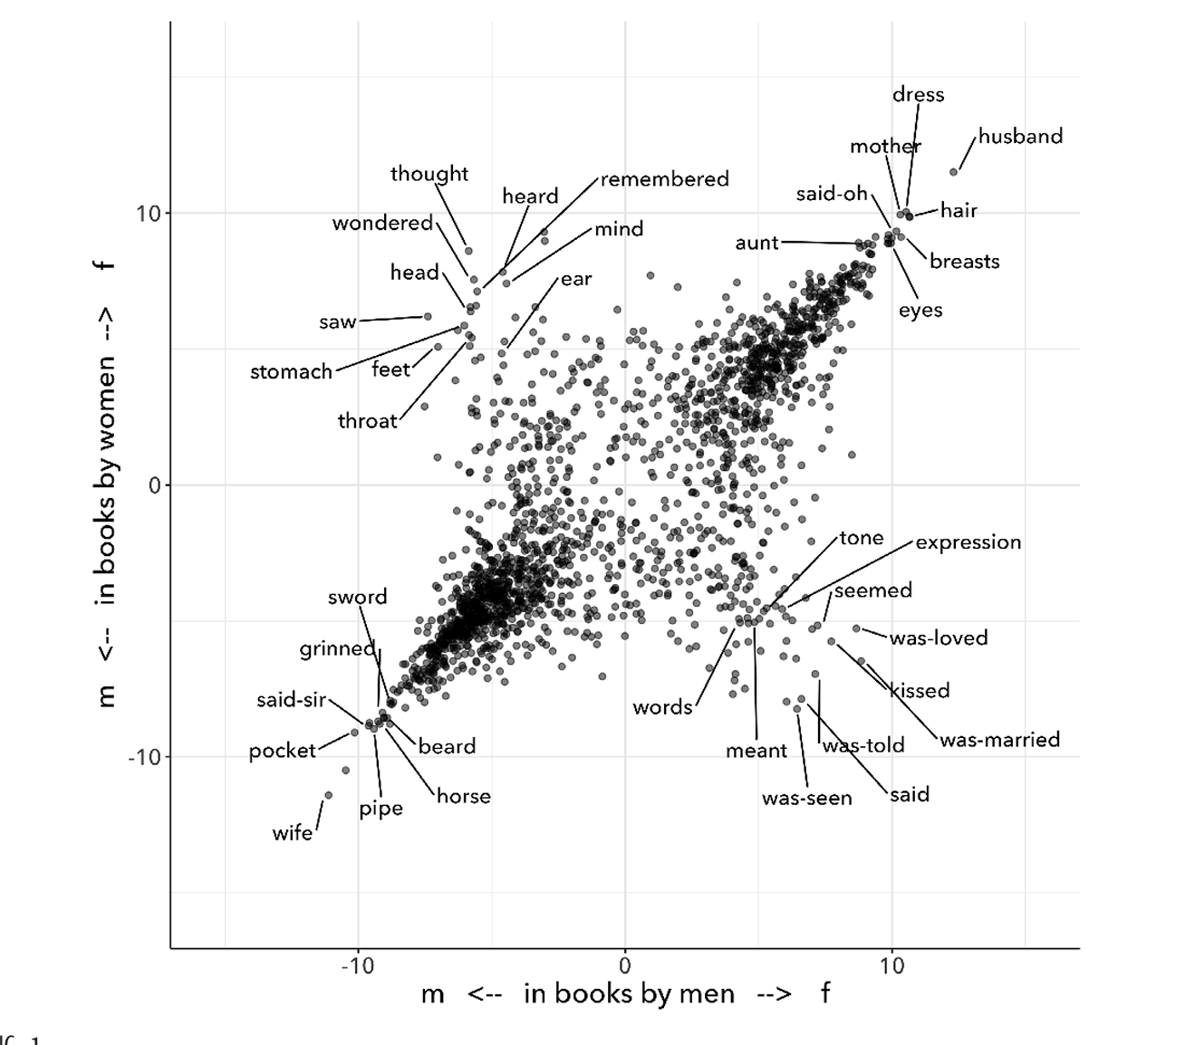
Machine learning and Human perspective

Slide 11
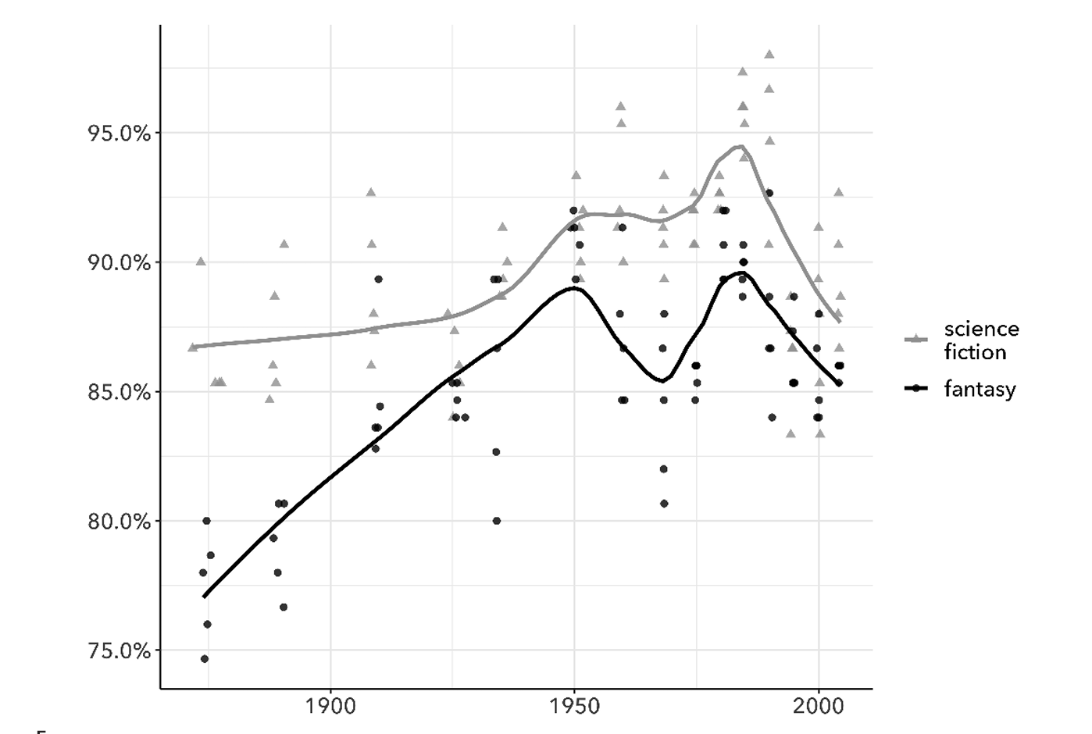
Machine learning and Human perspective

Slide 12
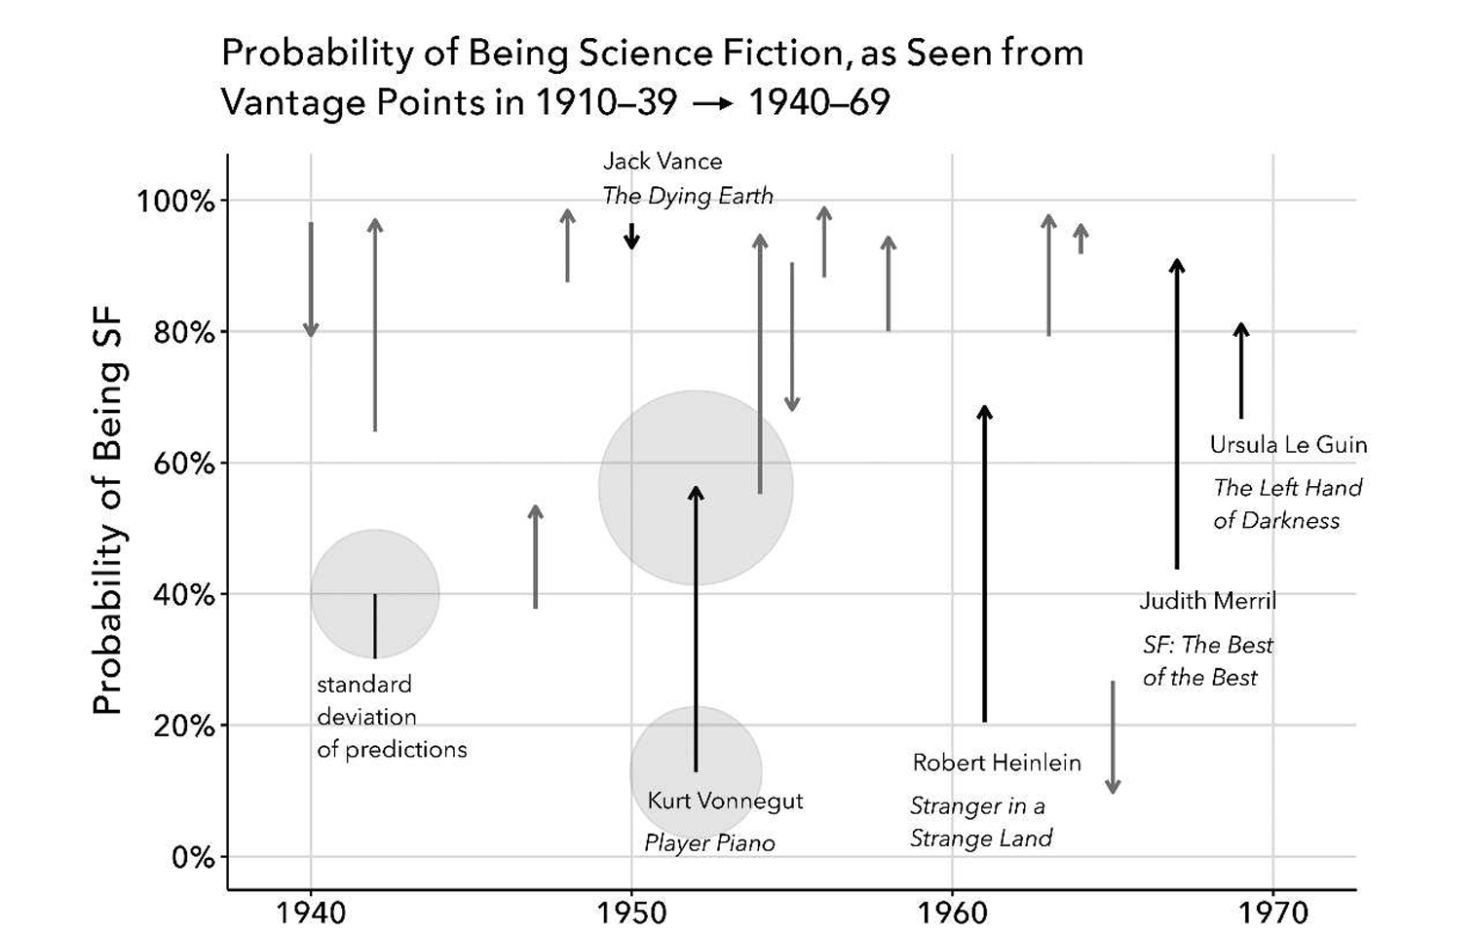
Machine learning and Human perspective

Slide 13
Machine learning and Human perspective
What is Underwood’s central argument about machine learning and “perspective”? How does this challenge the idea that computational methods are objective?
How does Underwood use science fiction and fantasy to demonstrate this argument? What did you find most interesting or surprising about the results?
Why does it matter that Underwood builds models from classifications made by different groups—from historical advertisers to contemporary librarians? What do these different perspectives allow him to see?
More broadly, what does this example suggest machine learning can—and cannot—contribute to literary interpretation?

Slide 14
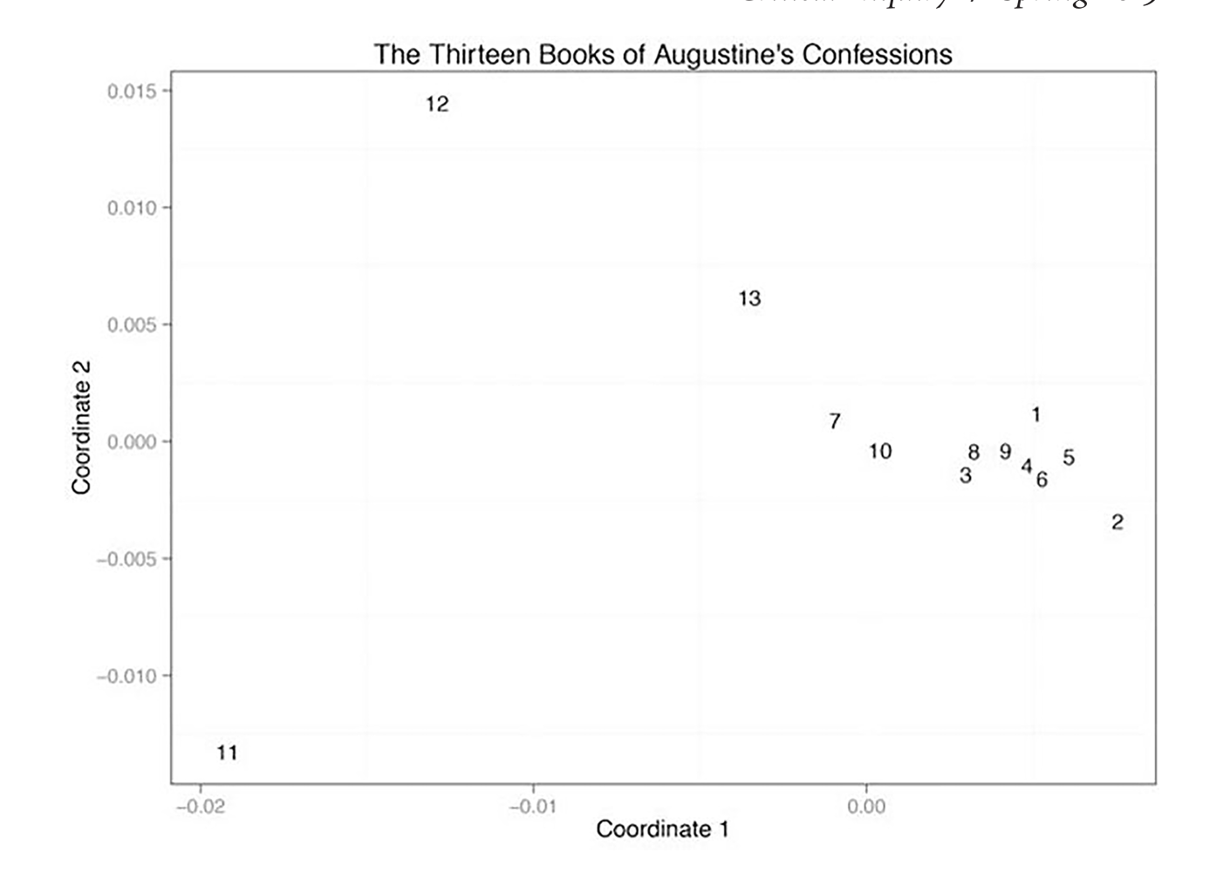
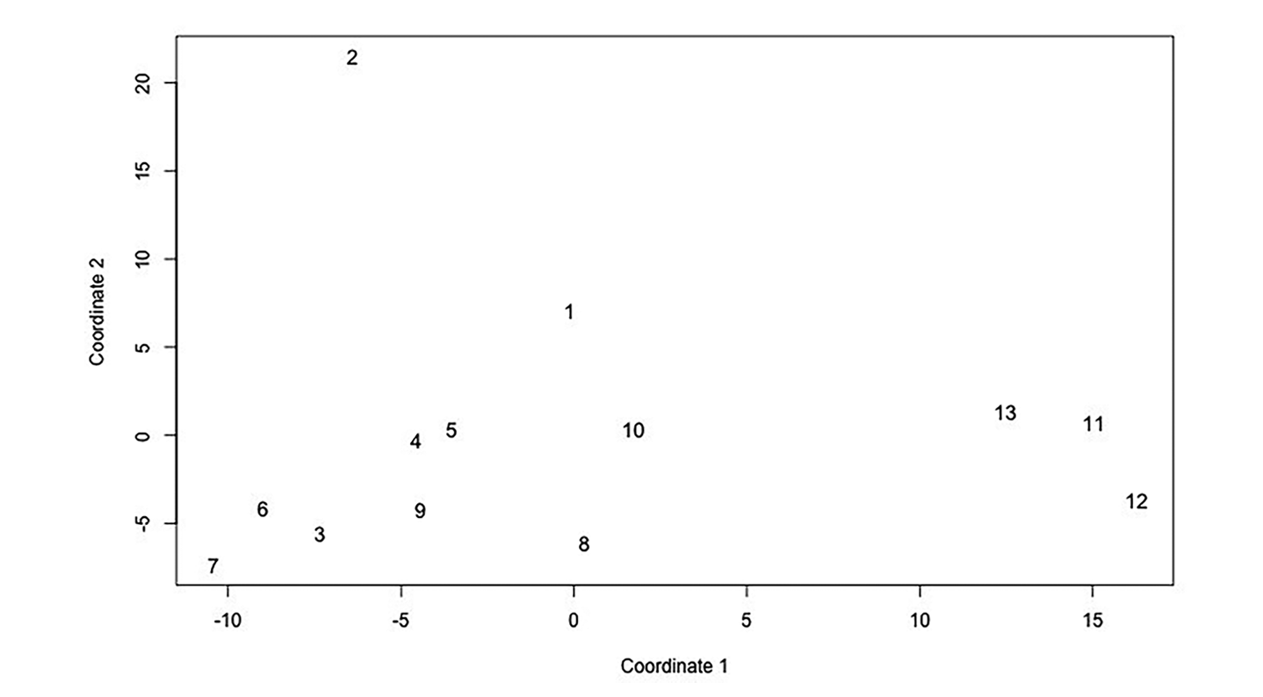
The computational case against computational literary studies

Slide 15
The computational case against computational literary studies
What is Da arguing against? What does she see as the fundamental problems with computational literary studies—not just individual studies or methods?
Which of Da’s critiques did you find most convincing? Which were you less convinced by?
Da published this critique in 2019. How might developments in computational methods since then complicate or limit her argument? Which of her criticisms are methodological problems that newer or better methods might address, and which are more fundamental?
Even if we reject Da’s larger conclusion about CLS, what warnings should computational researchers still take seriously?

Slide 16
Teaching quantitative methods (What makes it hard)
According to Goldstone, what makes learning quantitative or computational methods difficult for students of literature? Did any of these challenges resonate with you?
What distinction does Goldstone make between learning to code and learning to conduct quantitative research? Why does that distinction matter?
Goldstone describes several examples of students analyzing literature computationally. Which examples or possibilities stood out to you?
What does Goldstone suggest we can—and cannot—learn simply by counting, measuring, or visualizing features of texts?
After reading Goldstone, what questions or concerns do you have about learning computational methods in this course?

Slide 17
Digital text methods demo
Frequency Analysis in Voyant: https://voyant.lincsproject.ca/?corpus=shakespeare
Supervised Machine Classification with Python: https://colab.research.google.com/drive/1Vz_n3qLmQCwkgMHoq1JK1RR6haLh8fa0?usp=sharing

Slide 18
Due Next week
Complete Readings:
Peter Boot, “‘A Pretty Sublime Mix of WTF and OMG’: Four Explorations into the Practice of Evaluation on Online Book Reviewing Platforms” (2023)
Mark Algee-Hewitt et al., Canon/Archive: Large-Scale Dynamics in the Literary Field (2016)
Ted Underwood, David Bamman, and Sabrina Lee, “The Transformation of Gender in English-Language Fiction” (2018).
Katherine Elkins, “Beyond Plot: How Sentiment Analysis Reshapes Our Understanding of Narrative Structure” (2025).
Review Corpora:
CLiC Fiction Corpora: nineteenth-century British novels and children’s literature
Folger Shakespeare Corpus: Shakespeare’s plays and poetry
Project Gutenberg Poetry Corpus: a large collection of public-domain English-language poetry

